Slide 1
Software Requirements Specification
for
Double Pendulum
Zhi Zhang
McMaster University

Slide 2
Presentation outline
Introduction
Goal Statement
Assumptions
Theoretical Models
Instance Models
Functional Requirements
Challenges

Slide 3
introduction
https://www.myphysicslab.com/pendulum/double-pendulum-en.html
Notes:
A double pendulum consists of two pendulums attached end to end. With 2 limbs and 2 masses, a double pendulum can perform various motions. 然后去网站演示double pendulum。 From the simulation, we can see that the moving curve of a double pendulum is highly sensitive to the initial conditions.

Slide 4
Goal Statement
To determine the equations of the movements of the system
To demonstrate the double pendulum’s strong sensitivity to initial conditions

Slide 5
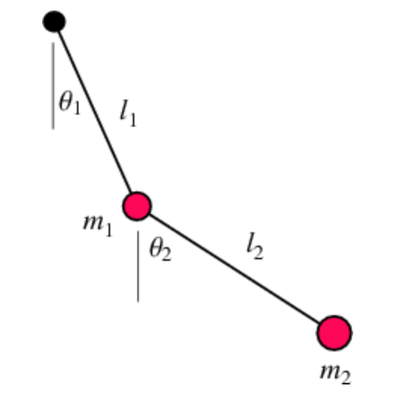
assumptions
The motion of the double pendulum is two-dimensional
The weight of two limbs are neglected
Time starts at zero
Air drag is neglected
Notes:
goal: only show the graphs
air drag not neglected

Slide 6
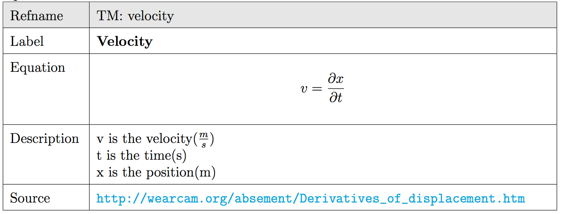
Theoretical models
Notes:
data definition
kinetic energy is the theoretic

Slide 7
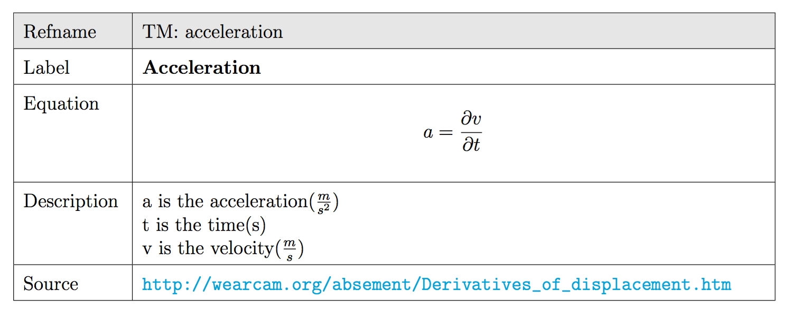
Theoretical models

Slide 8
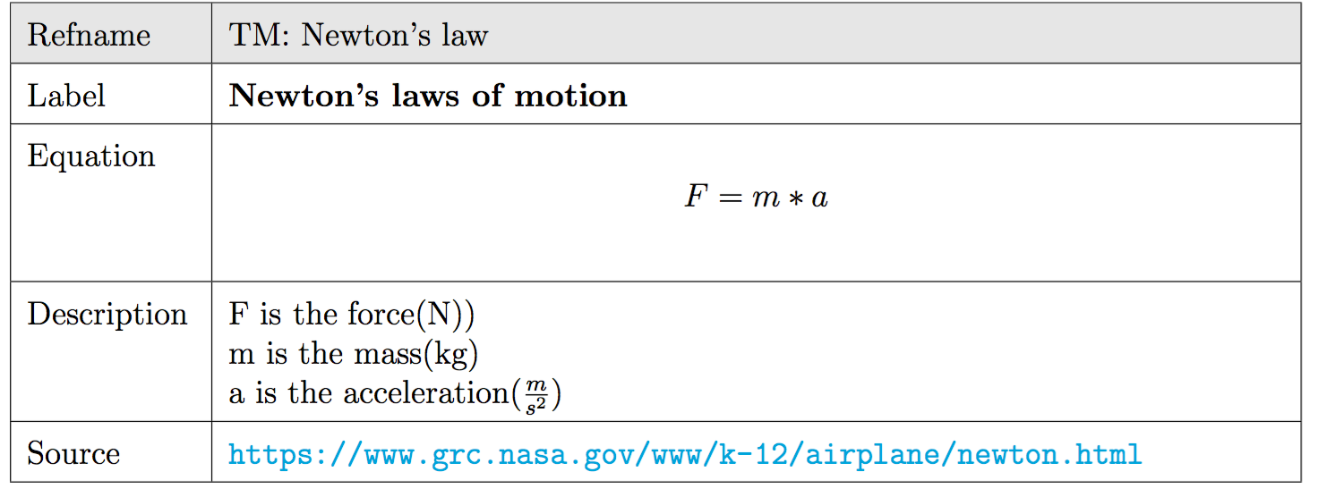
Theoretical models

Slide 9
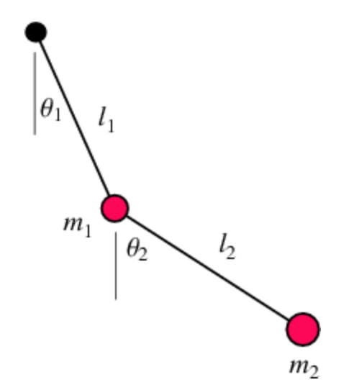
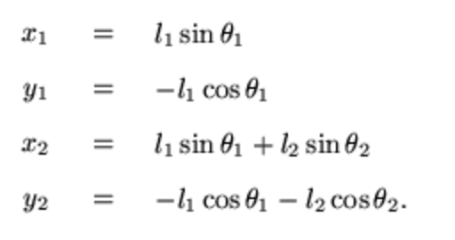
Instance Models
The position of the bobs are given by:

Slide 10
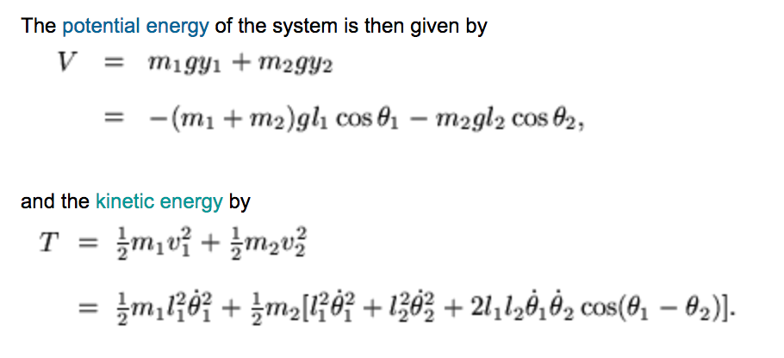
Instance Models
Notes:
Then use the Euler-Lagrange differential equation to solve theta 1 and theta 2, so we can plot the resulting solutions.

Slide 11
Functional requirements
Output
the equations of the movements
the graph of the movements
Input:
the weights of two masses
the length of two limbs
the gravity
Notes:
highly sensitive to the initial conditions, which makes it a chaotic system
For large motions it is a chaotic system, but for small motions it is a simple linear system.
theta 1 theta2 not 垂直
the function theta 1 and theta 2
做出visual

Slide 12

Questions?

Slide 13
Thank you for listening!

